Slide 1
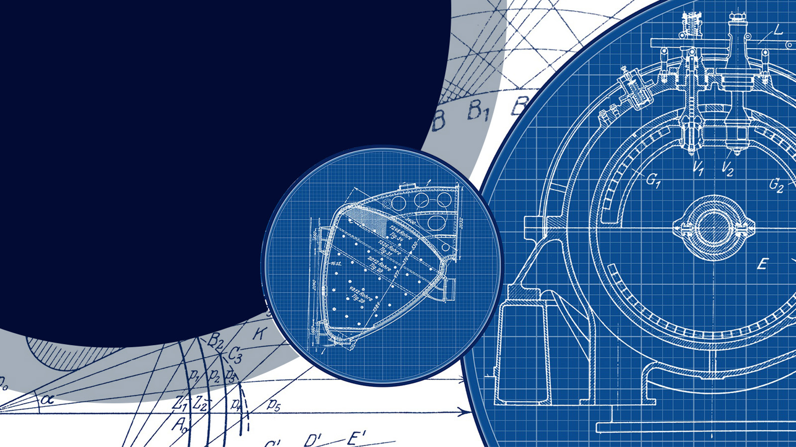

DURGA
AUTO INDUSTRIES
CRAFTED FOR BRILLIANCY.
W E L C O M E
AN ISO 9001:2015 Certified Company

Slide 2


INTRODUCTION
🏢 DURGA Auto Industries
Engineering Growth Since 1992
📍 Ludhiana, Punjab
Two manufacturing unit with 38,000 sq. ft. of advanced infrastructure
🔧 Business Focus
Precision manufacturing & assembly of sheet metal pressings
Serving Tier-1 & Tier-2 Automotive, White Goods, and Export sectors
🤝 Trusted Partners
KINETIC GREEN ENERGY & POWER SOLUTIONS |JBM GROUP | SATYAM AUTO COMPONENTS | EASTMAN EXPORT | And more
🏭 Facility Location
UCO Bank Road, Jugiana, Ludhiana
🎯 Core Values & Vision
Seamless synergy of technology, systems, and human capital
Commitment to quality, performance, and cost-effective solutions
Driving innovation, upholding ethical standards, and championing social responsibility

Slide 3
COMPANY POLICIES
QUALITY POLICY
We at Durga Auto Industries are committed for continual improvement of QMS and total customer satisfaction through.
Systems that fulfill needs and expectations of interested parties.
Up gradation of new innovation and technology.
Reduced variation and waste.
Achievements of objectives leading to excellence & growth.
Joyful, healthy and safe environment with compliance to applicable requirements.
ENVIRONMENT POLICY
Preserve and continually improve the environment with minimum wastage of resources, reduction in pollution and by creating awareness amongst management, employees, suppliers and community.
Protect environment by complying and environment legal and other related requirements.

Slide 4
INFRASTRUCTURE
🏭 Infrastructure Highlights
📍 Located in the industrial zone of Ludhiana, Punjab
🏢 Total plant area: 38000 sq. ft.
🧰 Well-equipped Tool Room for in-house tool development
📏 Standard Room for quality control & inspection
📦 Dedicated Packing & Dispatch Zone for streamlined logistics
🔧 Separate Welding Shop & Fabrication Section for process specialization
🖥️ Modern Office Complex spanning 5,500 sq. ft

Slide 5
ORGANIZATION CHART
Doc.No.- DAI-F-01
Rev.No.- 05
Eff date- 01-04-2025
Managing Director
Mr Narinder Bassi
Marketing BDM
(Mr. Abhay)
Executive Director
Mr Shubham Bassi
Plant Head
Mr Jasvir Singh
Accounts Head
(Mr. Raj Kumar)
Quality Section
Tool Room Dept.
Maintenance Dept.
Production Dept.
Packing Section
Purchase Head
Tool Room Head
(Mr.Harshdeep )
Design & NPD.
(Mr. Sarabjeet Singh)
Dispatch Inch.
(Mr Shubham)
Mrs. Simran Arora
Quality Head
(Mr. Sushil)
Maintenance Head
(Mr. Pritam Singh)
Production Head
Mr. Naveen
Die fitter
(Mr.Harwinder Singh)
Turning Section
Welding Section
Maintenance
(Mr. Malkit Singh)
Die Setters
Mr. Rishi Chawla
Quality Engineer
(Mr. Vishwajeet)
Turning Foreman
Mr.Birju Yadav
(Mr.Arun Kumar)
W.Shop Supervisor
Mr. Vinay
Human Resource
DieFitter
(Mr. Hardeep Singh)
Junior Fitter
(Mr.Chandan)
(Mr. RAM Kumar)
Mr. Rajat Kumar
Jr. DieFitter
(Mr. Om Prakash)
(Mr. Pintu)

Slide 6
OUR SYSTEM
Quality & Process Controls:
🔄 Periodic performance reviews to ensure plant-level efficiency
📋 Internal & process audits for continuous quality enhancement
⚙Error-proofing (Poka-Yoke) initiatives to reduce defects
Supply Chain & Inventory Management:
✅ Systematic supplier evaluation and selection methodology
🏷️ Material identification & FIFO implementation for traceability and flow
Production Support & Maintenance:
📐 Availability of updated customer drawings at all stages
🧯 Preventive maintenance schedules to ensure machine uptime
🔴 Red Bin analysis for non-conforming materials
Customer-Centric Approach:
📣 Customer complaint tracking and corrective action systems in place
Inspection & Control Systems
First-Off, Last-Off, Stage & Pre-Dispatch Inspection
Process Inspection as per Control Plan
PFMEA (Process Failure Mode & Effects Analysis)
Layout Inspection & SPC (Statistical Process Control)
MSA (Measurement System Analysis)
Maintenance & Calibration
Machine, Fixture & Die Maintenance
Instruments & Gauges Calibration
Monitoring Key Performance Indicators (KPIs)
Operational Discipline & Training
Structured Operator Training Programs
Monitoring of Safety Systems
Raw Material Control & BOP (Bought-Out Parts) Checks
Outsourced Process Control
Culture of Excellence
Continual Process Improvement Across Departments
DURGA AUTO INDUSTRIES

Slide 7
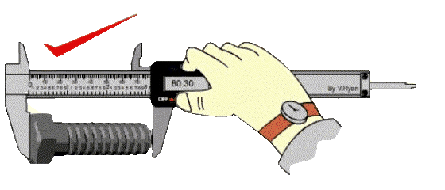
QUALITY
“At DURGA Auto, we believe that quality input ensures quality output.”
✅ End-to-End Quality Control
Every stage — from raw material to final dispatch — is monitored through structured quality protocols
All workers operate under well-defined quality guidelines to ensure consistency and precision
🔍 In-House Inspection Capabilities
We are equipped with a comprehensive range of precision instruments, including:
Surface Plate
Height Gauge
Micrometer
Dial Vernier Caliper
Digital Vernier Caliper
Puppy Dial
Dial Gauge
Hardening Tester
…and many more for accurate dimensional and surface evaluations
🧩 Our rigorous checks and skilled team ensure that each product meets the highest standards before it leaves our facility.

Slide 8
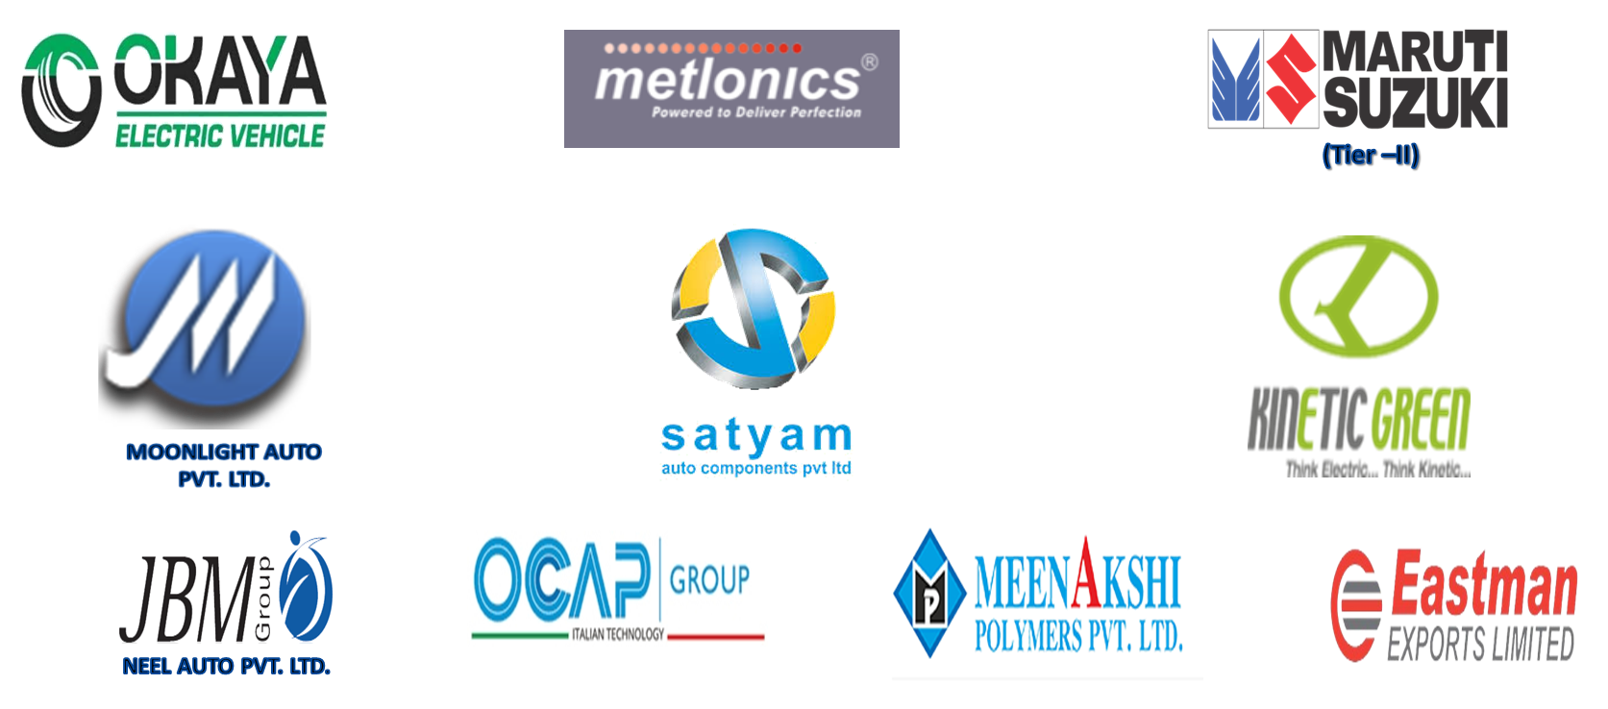
OUR CUSTOMERS

Slide 9
APPROVED RAW MATERIAL SOURCE
To ensure consistent product quality and material integrity, we source raw materials only from certified and reputable suppliers:
Supplier Name | Key Credentials
Sangeeta Steel (Tata Supplier) | Authorized source of Tata-grade steel
Hanumant Steel Traders | Reliable supplier of industrial-grade steel
Technico Strips and Tubes Pvt. Ltd. | Specialized in precision strips & tubing
Bhushan Steel | Premium steel products for automotive use
Great India Steel Company | Trusted partner for rolled and alloy steels
🔒 All suppliers are regularly evaluated to meet our material traceability, compliance, and performance benchmarks.

Slide 10
KEY FUNCTIONAL SECTIONS
🔧 Tool Room
In-house facility for rapid tooling, die development, and fixture fabrication — ensuring design flexibility and time efficiency
⚙Press Shop
High-speed sheet metal forming with progressive, compound, and draw tooling capabilities for varied component geometries
🔩 Welding Section
Dedicated bays for MIG, ARC, Spot, and Projection welding, supported by trained technicians and rigorous weld quality protocols
🌀 Turning Section & CNC
Equipped with manual, semi-auto, and CNC machines to handle complex turning, threading, and machining operations with precision
📏 Standard Room
Environmentally controlled quality lab equipped with calibrated instruments for inspection, testing, and documentation

Slide 11
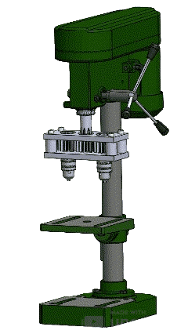
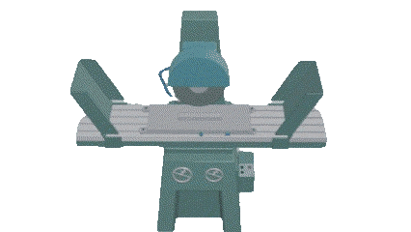
TOOL ROOM
⚙️ Tooling & Growth Excellence
🔧 In-House Capabilities
Rapid development of components and tooling within our fully equipped Tool Room
Timely delivery as a core value of our manufacturing operations
📈 Growth Driven by Trust
Steady horizontal expansion across products and processes
Backed by nearly 30 years of enduring customer confidence
A reflection of our unwavering commitment to quality, reliability, and innovation
Machine Type | Quantity | Purpose
Surface Grinder | 02 | Finishing flat surfaces with high accuracy
Lathe Machine | 02 | Shaping metal components via turning process
Shaper Machine | 01 | Cutting and shaping flat surfaces
Drill Machine | 02 | Precision drilling and boring
Vertical Milling (with DRO) | 03 | High-precision milling with digital readout
Bench Grinder | 02 | Tool sharpening and surface finishing
🛠️ Each machine is operated by trained personnel under strict quality protocols to ensure tool integrity and production consistency.

Slide 12
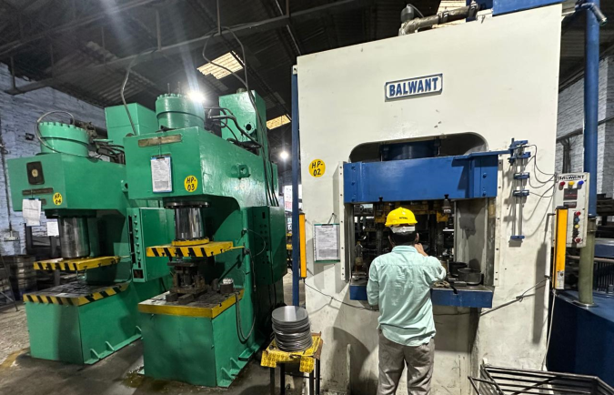
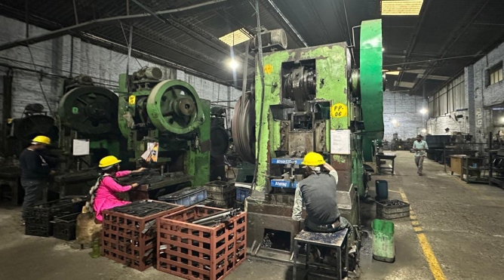
PRESS SHOP
List Of Machines
S.No | MACHINE NAME | TYPE | CAPACITY |  | QTY. | BED SIZES
1 | Pneumatic Press | H | 350 | Ton | 1 | 1200 | 1200 | 650
2 | Hydraulic Press | H | 150 | Ton | 1 | 762 | 762 | 610
3 | Hydraulic Press | H | 400 | Ton | 1 | 1000 | 1000 | 650
4 | Hydraulic Press | C | 200 | Ton | 2 | 630 | 900 | 600
5 | Hydraulic Press | H | 200 | Ton | 1 | 805 | 910 | 940
6 | Power Press | H | 250 | Ton | 1 | 800 | 800 | 460
7 | Power Press | H | 200 | Ton | 1 | 813 | 737 | 585
8 | Power Press | H | 150 | Ton | 4 | 661 | 661 | 450
9 | Power Press | C | 150 | Ton | 3 | 712 | 661 | 508
10 | Power Press | H | 100 | Ton | 5 | 612 | 661 | 534
11 | Power Press | C | 100 | Ton | 3 | 915 | 1017 | 508
12 | Power Press | H | 75 | Ton | 2 | 661 | 585 | 533
13 | Power Press | C | 75 | Ton | 1 | 812 | 915 | 394
14 | Power Press | H | 50 | Ton | 12 | 660 | 517 | 381
15 | Power Press | C | 50 | Ton | 3 | 508 | 762 | 330
16 | Power Press | H | 30 | Ton | 4 | 533 | 458 | 318
17 | Power Press | C | 30 | Ton | 3 | 520 | 762 | 482
18 | Power Press | C | 20 | Ton | 6 | 355 | 533 | 318
19 | Power Press | C | 10 | Ton | 2 | 267 | 355 | 191

Slide 13
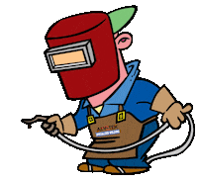
WELDING MACHINE
Our dedicated welding department supports high-volume and precision fabrication, ensuring strength and consistency across all components.
S.NO. | MACHINE NAME | QTY.
1 | MIG WELDING MACHINE | 13
2 | PROJECTION WELDING | 1
3 | ARC WELDING | 2
4 | SPOT WELDING | 1

Slide 14
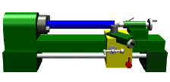
TURNING SECTION
🔧 Machining Capabilities Overview
Our Turning Section is equipped to handle a wide range of precision operations, from manual machining to specialized bending and threading — all supported by skilled personnel and strict quality protocols.
🛠️ All machines are integrated into a structured workflow optimized for timely delivery and high-quality output.
Machine Type | Qty | Functionality
Manual Turning Machine | 10 | Precision hand-controlled shaping & finishing
Automatic Turning Machine | 03 | High-volume, repeatable turning operations
Grinder Machine | 03 | Surface smoothing & edge refinement
Thread Machine | 01 | Threading operations for bolts & fasteners
Semi-Automatic Turning Machine | 01 | Hybrid flexibility with manual override
Drill Machine | 08 | Multi-purpose drilling across components
Milling Machine | 02 | Surface profiling & dimensional shaping
Power Hex Machine | 01 | High-speed cutting with hexagonal output profiles
SPM Bending Machine | 01 | Custom metal bending for specialized components
Shearing Machine | 01 | Clean cutting of metal sheets with precision
DURGA AUTO INDUSTRIES

Slide 15
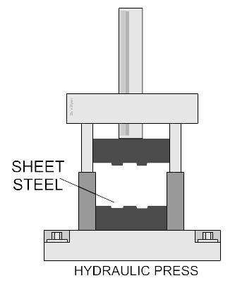
PRODUCT PORTFOLIO
We specialize in manufacturing a comprehensive range of components and tools designed for precision, durability, and diverse industrial applications:
🔧 Component Manufacturing
Sheet metal components
Machining and tubular components
Welded assemblies (sheet & tubular parts)
Stainless steel forged parts
📐 Tooling & Fixtures
Press tools (progressive, compound, draw tools)
Custom-designed jigs and fixtures
Precision gauges and measurement tools
🌍 Our extensive in-house capabilities ensure flexibility, accuracy, and quality — meeting evolving customer needs across global markets.

Slide 16
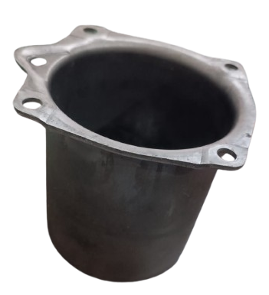
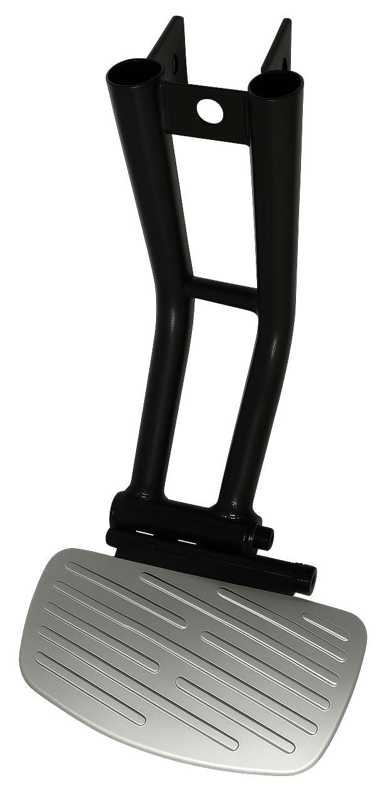
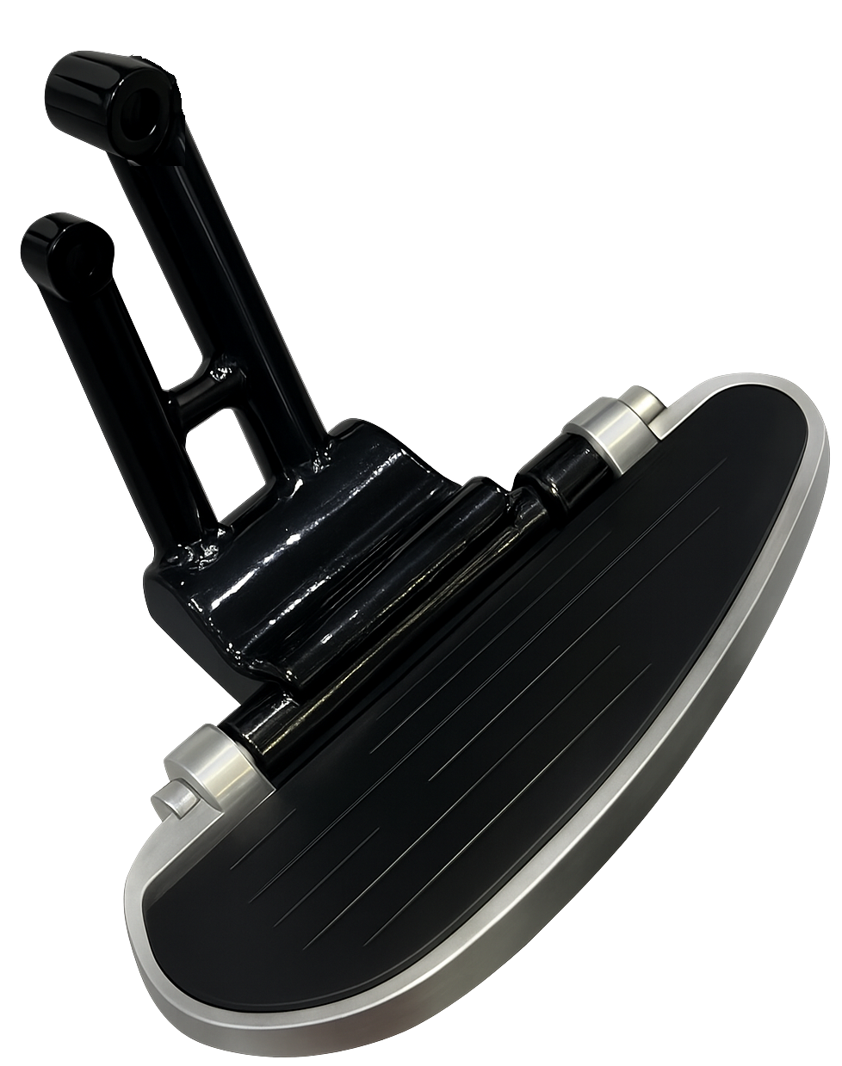
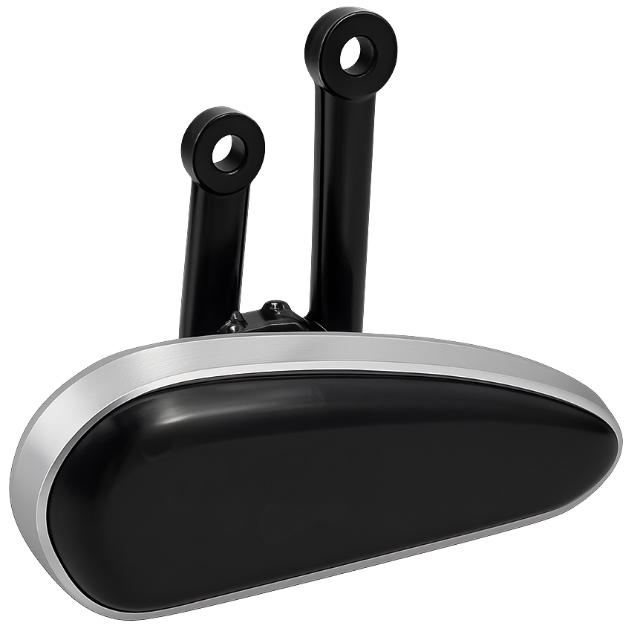
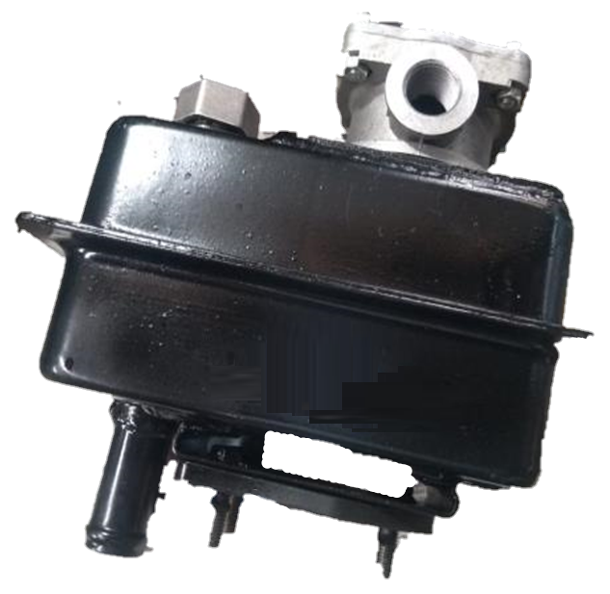
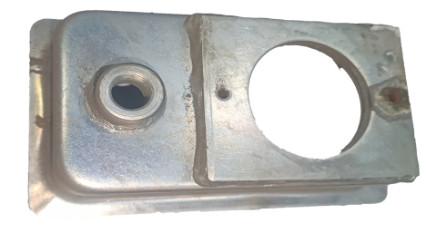
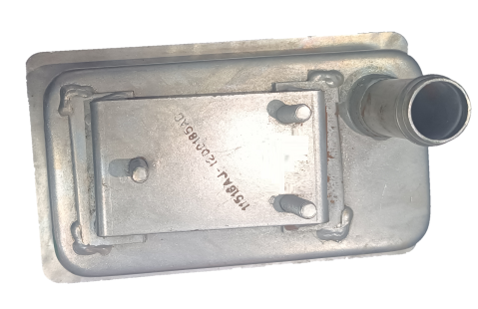
Products
(ASSEMBLY PARTS)
Ladies Foot Rests
Pneumatic Body
Steering fuel tank
DURGA AUTO INDUSTRIES

Slide 17
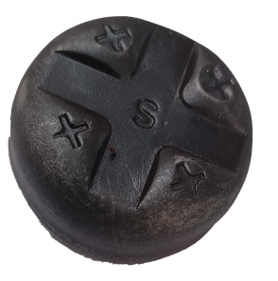
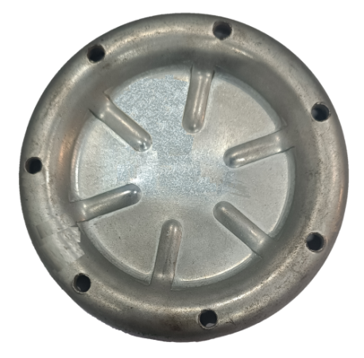
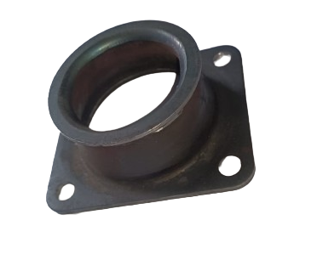
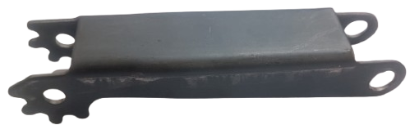
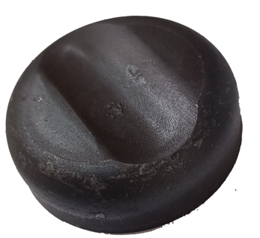
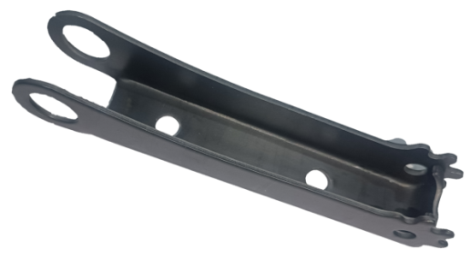
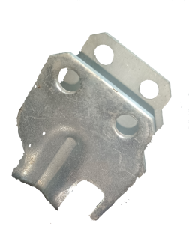
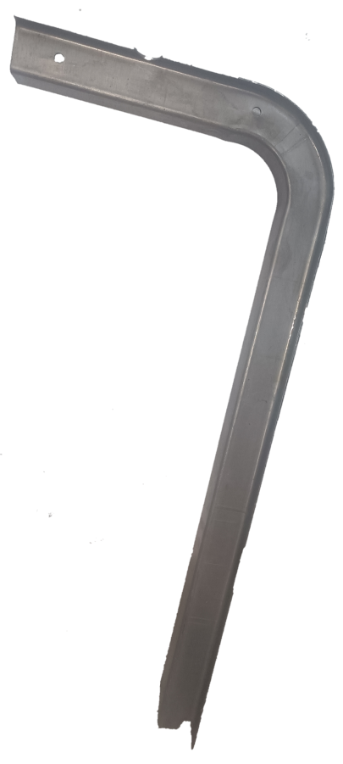
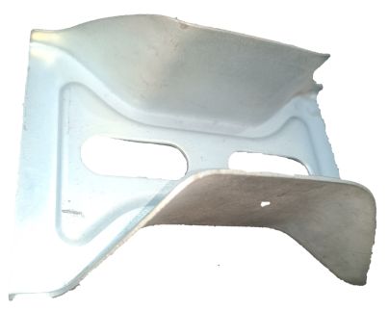
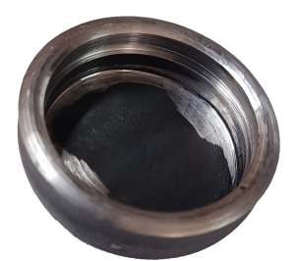
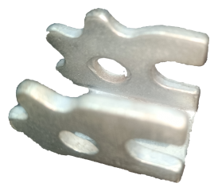
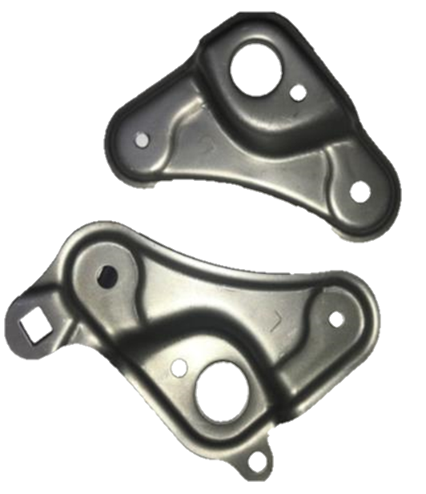
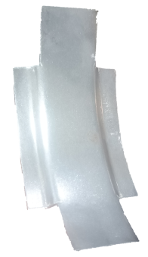
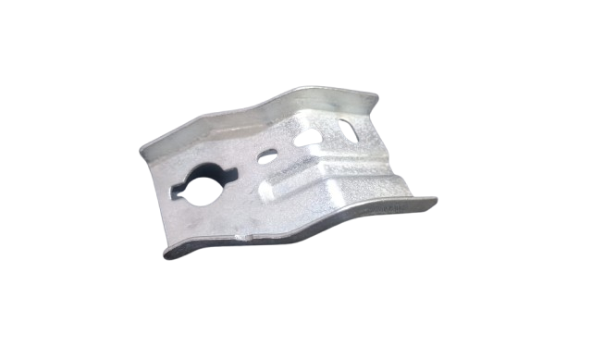
Products
(FORMING PARTS)
Base plate
Jack
Jack Caps
Engine Mount
Brake Switch MTG Brkt
Stiffener penal
round cover
Stiffener
Mounting Brackets

Slide 18
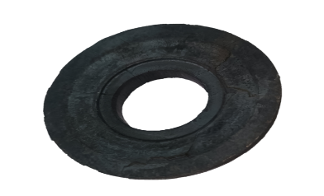
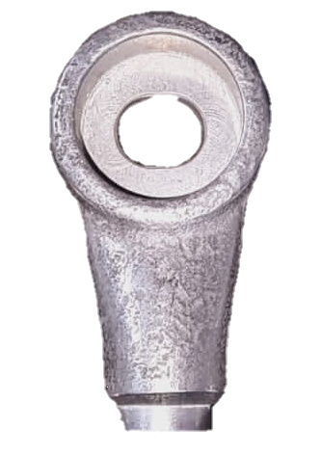
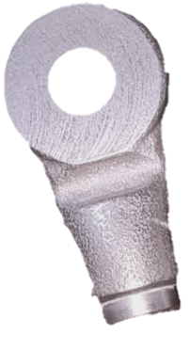
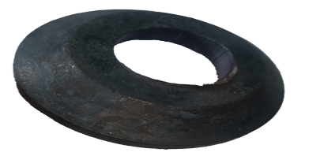
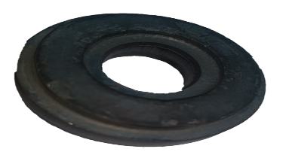
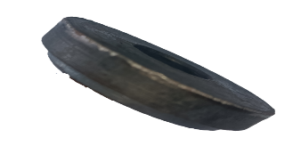
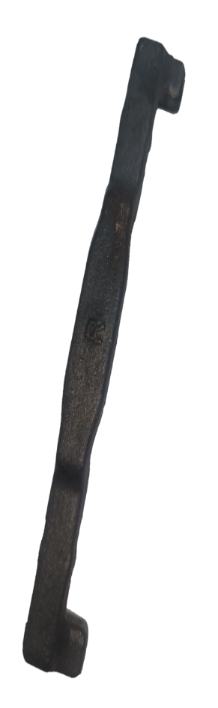
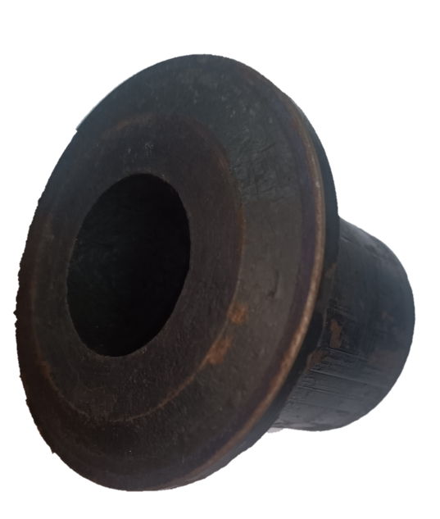
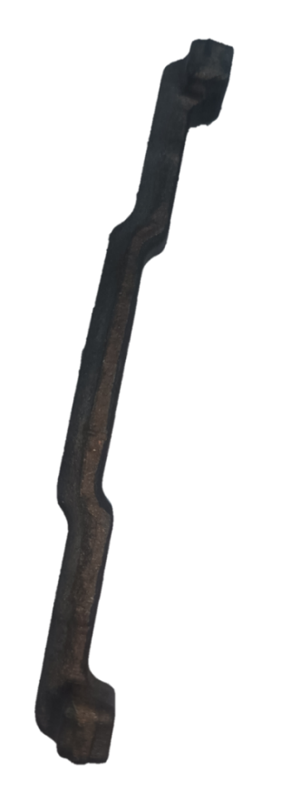
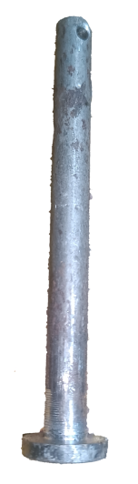
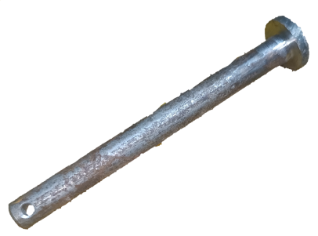
Products
Forging Parts (BOP)
Mounting Bracket
Warshers
SS Rod Engine Guard
Coupling
DURGA AUTO INDUSTRIES
Seat Hinge Rod

Slide 19
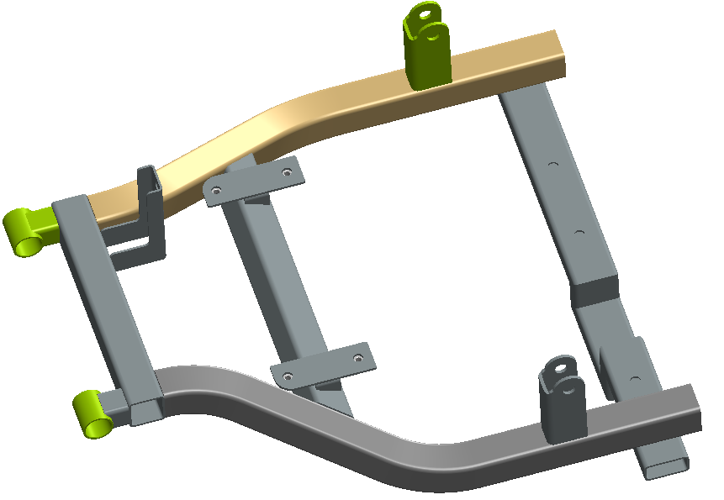
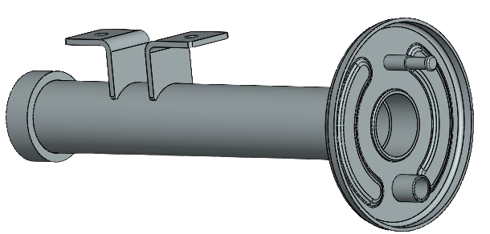
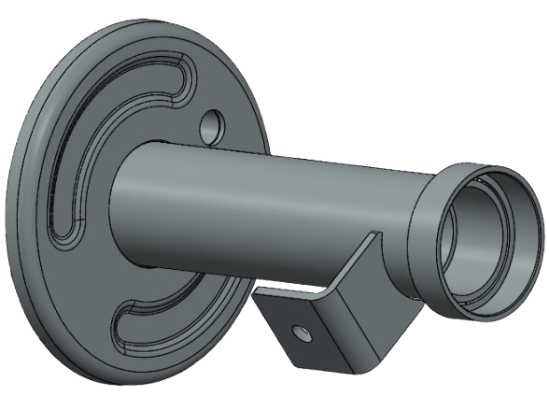
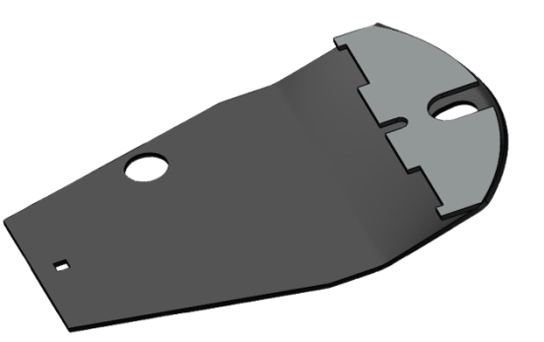
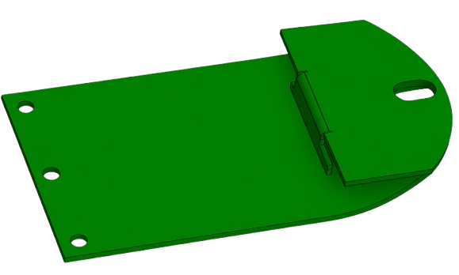
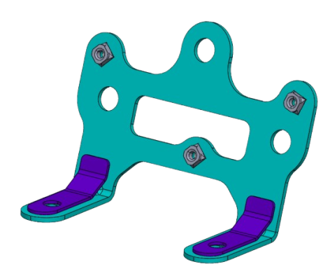
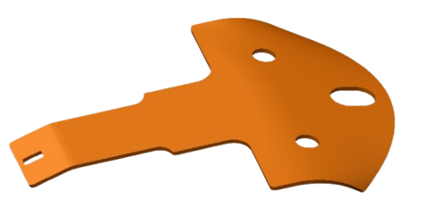
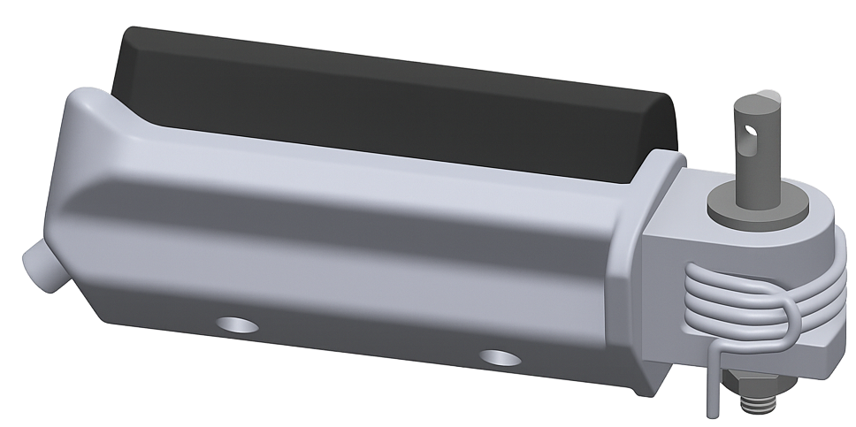
UPCOMING PROJECTS
OUTER HOUSING LH/RH
EV SCOOTER PARTS
SWING ARM
EV SCOOTER PART
SKID
(AGRICULTURE PARTS)
Gents Footrest
Stay Meter Sub Assembly
DURGA AUTO INDUSTRIES

Slide 20
Sales Growth

Slide 21


Expansion Plans
AREA OF 20000 SQ. FEET.
POWER BACKUP-250 KVA
PROPER SHED AND FLOORING
DURGA AUTO INDUSTRIES

Slide 22
About Us.
📊 Performance Snapshot
💰 Annual Turnover: ₹20 Crore (approx.)
👥 Team Strength: 120+ dedicated employees
🛡️ Workplace Safety: Strict adherence to safety protocols across all operations
⏱Timely Delivery: Punctual order fulfillment with optimized supply chain coordination
🎯 Customer Satisfaction: Committed to quality-driven service and long-term client relationships
  Our mission
Deliver products that consistently meet or exceed customer expectations
Pursue continual improvement in products and processes to remain competitive
Embrace globalization through localization, serving markets with region-specific solutions
Innovate, develop, and manufacture with a focus on customer-centricity across all geographies
💡 “We strive not just to make parts—but to be a part of our customer’s success story.”
DURGA AUTO INDUSTRIES

Slide 23

Contact us :- DURGA AUTO INDUSTRIES
Uco Bank Road, Jugiana, Ludhiana, Punjab. 141017
: Info@durgaautoindustries.com
Mr. Narinder Bassi (MD) +91-94170-31638
Mr. Shubham Bassi (ED) +91-70098-36736
N
K
A
Y
H
O
T
U

